Slide 1

PLACEMENT MANAGEMENT SYSTEM
Under the guidance of
Anjana sarode
(technical trainer of edubridge)
batch:2021-6258
Center:banglore

Slide 2
Our team member
Ravina R Kumaras
Suraksha Kharvi
Sweta Sharma
Sangeetapriya

Slide 3
introduction
Placement management system manages student information in the college with regards to placement.
Placement training plays a major role in shaping up the career goals of students.
It provides career guidence about avenues open after graduation.

Slide 4
objective
The main objective here is to replace the manual process of registering for campus placement.
It helps to maintain record of students record ,so it will be easy to access any time 24*7.

Slide 5
modules
Admin module
Admin can add,update,view and delete the records of students,colleges,and placement detail.
Student module
Students can update,delete and view their details.

Slide 6
Continue..
College module
In this module admin can add the college detail.
Admin can has the right of update and deletion of college details
Placement module
Admin can update,add,delete the placement details.

Slide 7
Technologies used
Front-end:Java/J2EE technologies HTML, CSS, JavaScript, Bootstrap, springBoot,SpringMVC
Back-end:MySQL workbench 8.0.23CE.
Middleware/Server: Apache Tomcat v8.5.
IDE: Spring Tool Suite 4.0
Browser: Best result on Google Chrome.
Operating System: Window 10.

Slide 8
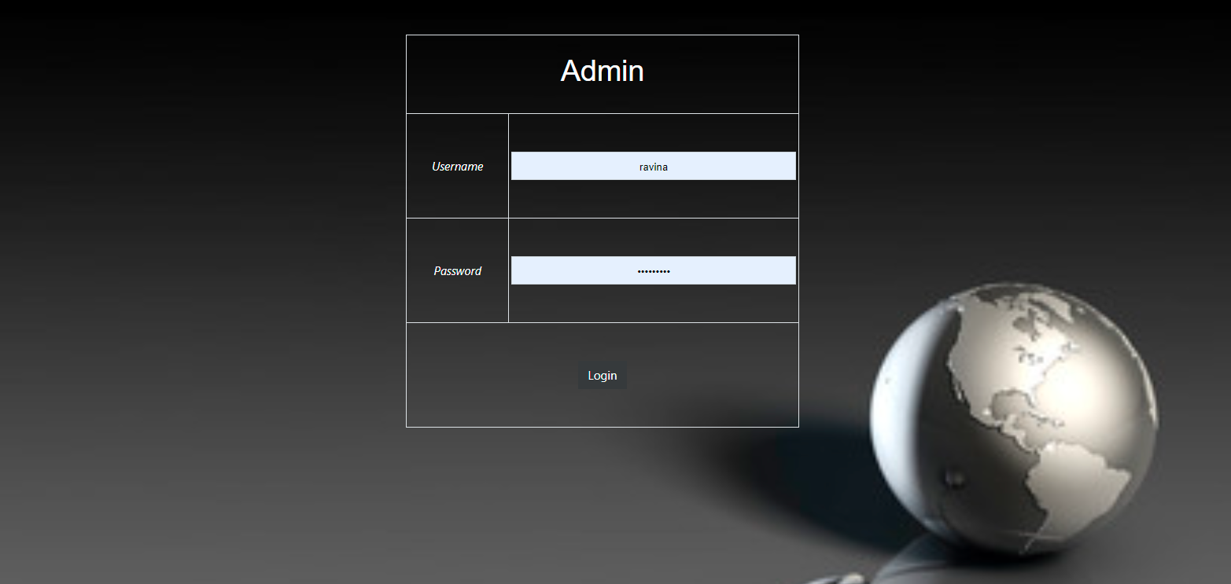
Screenshorts Admin module

Slide 9

Home page

Slide 10
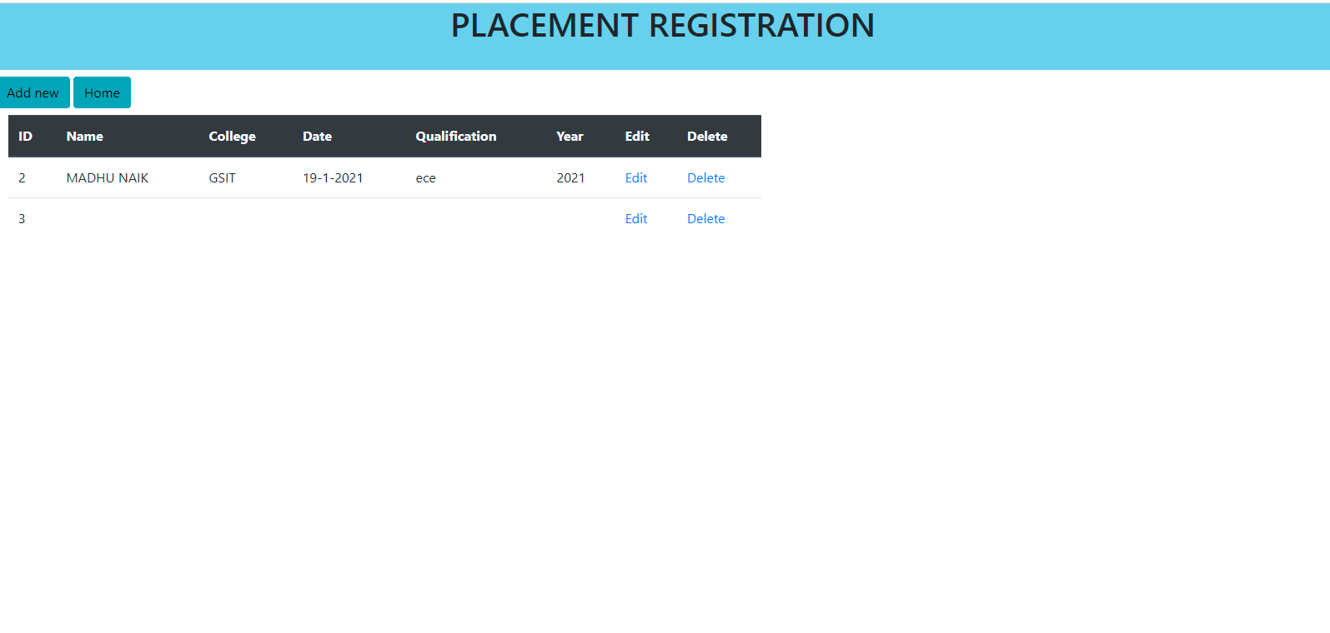
Placement registration module

Slide 11
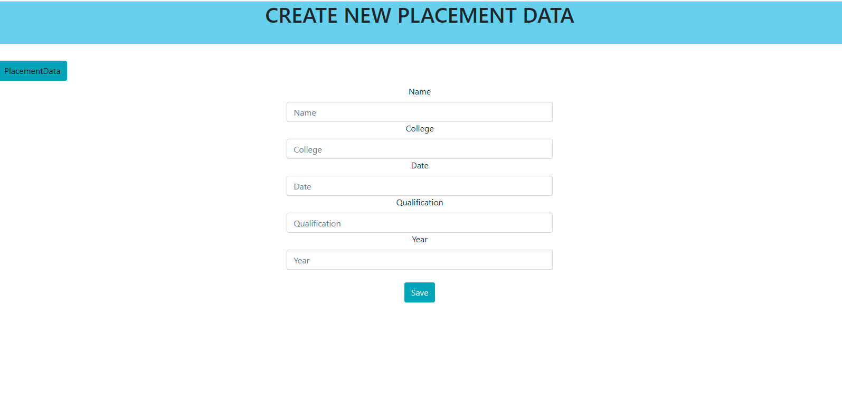
New placement data

Slide 12
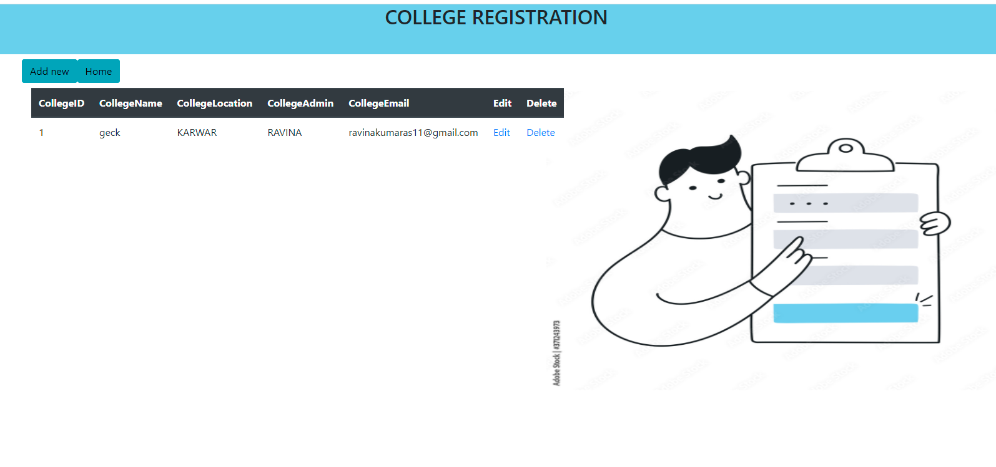
College registration page

Slide 13
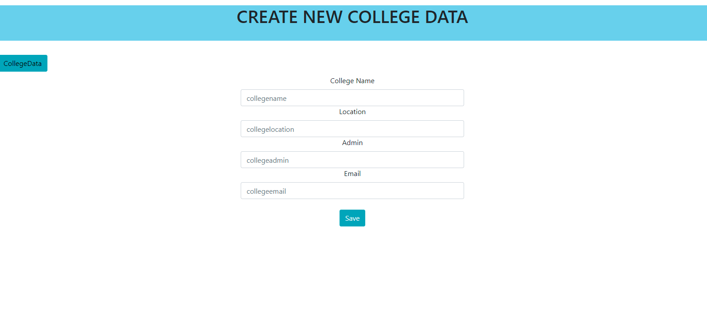
Create new college data page

Slide 14
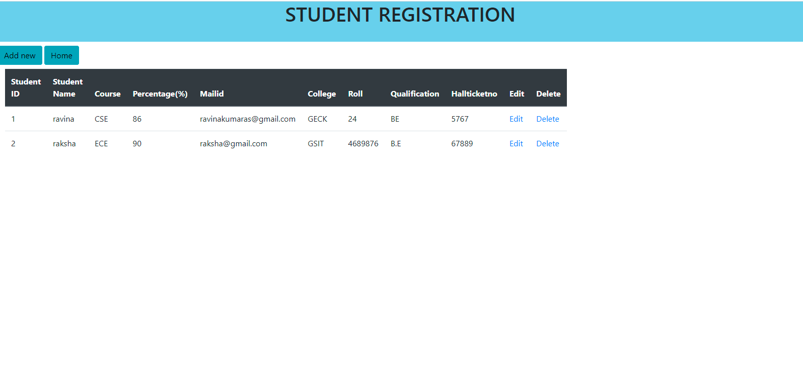
Student registration page

Slide 15
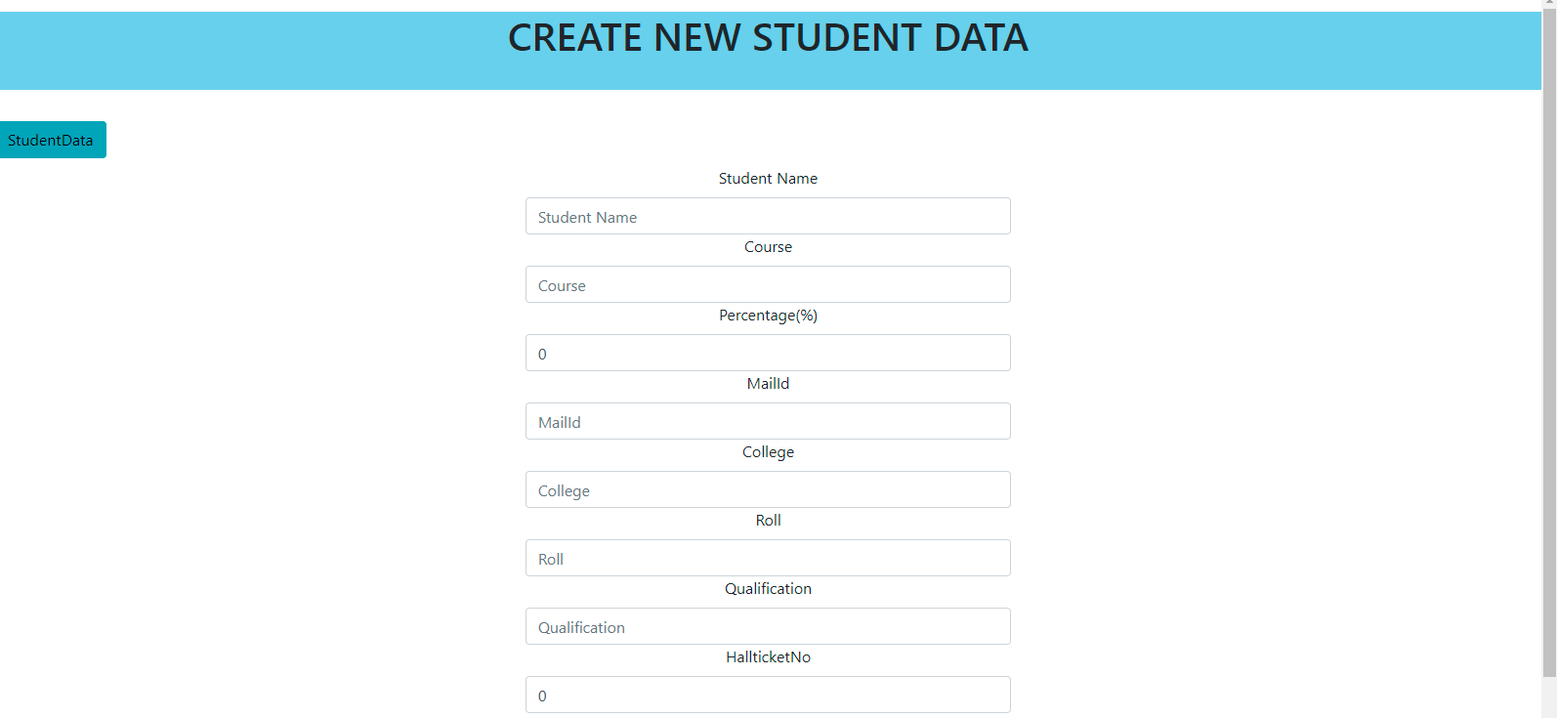
Create new student data

Slide 16

About us page

Slide 17
Thank you

